Slide 1


Chloramphenicol & Tetracycline

Slide 2

Chloramphenicol :
Chloramphenicol was initially obtained from streptomyces Venezuelae in 1947.
A natural product contains a nitrobenzene moiety.
Synthetic drugs are Yellowish white crystalline solid.
Stable in aqueous solution.
Nitrobenzene – antibacterial activity.

Slide 3
Mechanism of action.
Attaches to the 50s ribosome near the acceptor (A) site and prevents peptide bond formation between the newly attached amino acid and the nascent peptide chain.
Bacteriostatic – effective against a wide variety of organisms.
Mainly like tetracycline -+ve ,-ve ,Rikettsiae and mycoplasma
Generally used as drugs of last resort for life – threatening infections

Slide 4
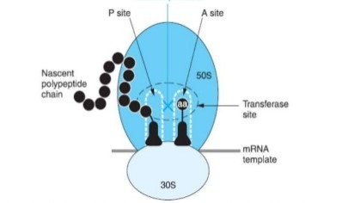

Slide 5
Pharmacokinetic
Completely absorbed after oral ingestion.
50-60% bound to plasma proteins.
freely penetrates serous cavities and blood –brain barrier.
CSF concentration is nearly equal to that of unbound drug in plasma.
Crosses placenta and secreted in bile and milk .
Plasma t1/2 of is 3-5 hours in adults.
primarily conjugated in Liver and little is excreted unchanged in urine.
Availability as capsules 250mg – 500mg (maximum dose 28mg in a course of less than 2 weeks
Also as inj. 0.25, 0.5 and 1 g per vial
Eye drops 0.4% and ear drops .

Slide 6
Adverse effects.
Irritative effects – Nausea , vomiting , diarrhoea and pain in injection
Bone marrow depression , aplastic anaemia, agrannulocytosis , thrombocytopenia
Hypersensitive effects – Rashes, fever .
Gray Baby syndrome : (2-9 days after dose of 100mg/kg)
within 24 hours , baby starts to vomit ,stops eating ,rapid and irregular respiration , abdominal distention, periods of cyanosis , and pooping loose green stool.

Slide 7
Baby then turns ashen gray and becomes flaccid and hypothermic
Also can occur in adults who are cirrhotics
Death in 40% of cases ( CVS collapse )
Due to Inhability to metabolised & excrete chloramphenicol
Bone marrow depression :
Idosyncratic reaction , Aplastic anaemia , Dose dependent – manifested as Anaemia , Leucopoenia , thrombocytopenia – reversible on stopping the drug

Slide 8
Therapeutic use.
Clinical use for systemic infection is now highly restricted
due to fear of fatal toxicity.
Combined formulation of chloramphenicol with any drug meant for internal use is banned in India.
Cephalosporins (vancomycin ) are presently the first line drugs for empirical therapy of bacterial meaningitis.
second line drug for H.influenzae.
Enteric fever : mainstay in the past
Meningcoccal meningitis
Anaerobic infection – bact. Fragilis
Inrtraocular infection – endophthalmitis
second choice – brucellosis , UTI, rickettsial infection, external ear infection.

Slide 9
Intraocular infection : Given systemically attains high concentration in ocular fluid . It is the preferred drug for endophthalmitis caused by sensitive bacteria.
Topically in conjunctivitis , external ear infection 0.5-5.0% is highly effective .
Topical use on skin or other areas is not recommended because of risk of sensitization.

Slide 10
2]Tetracyclines :
A class of antibiotics named for their nucleus of four (tetra) hydrocarbon rings.
All are obtained from soil actinomycetes
1948 first one – chlortetracycline (aureomycin) – s. aureofaciens ( yellow coloured colony)
Oxytetracyline from s. rimosus (1950)

Slide 11
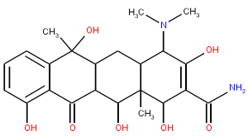

Slide 12
Naturally:
Tetracycline, cholrtetracycline,
oxytetracycline and demeclocycline
semisynthetic:
Doxycycline, minocycline , tigecycline ,
lymecycline, methacycline and
rolitetracycline .

Slide 13
Classification
Tetracycline
Short Acting
Tetracyclne
oxytetracycline
Intermediate Acting
Demeclocycline
Long Acting
Doxycycline

Slide 14
MOA
Inhibiting of bacterial protein synthesis by binding to 30s ribosomes – aminoacyl – t- RNA to mRNA – ribosome complex –

Slide 15
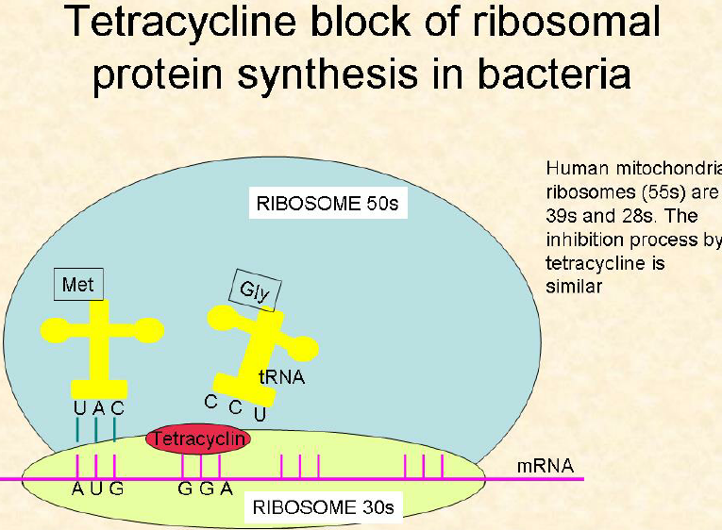
.

Slide 16
Pharmacokinetic
Older ones less absorbed – 60-80%(food interferes)but doxy and mino -completely
Distribution : wide and variable protein binding
- concentration in liver , spleen and bone &teeth
minocycline in fats.
- Good CSF penetration 1/4th of plasma – no
relation with inflammation.
Excretion : primarily in urine
– Doxycycline is exception (bile)
Preparation: oral capsules, ½ to 2 Hrs pre and post food - No IM: painful (oxy and tetra available.

Slide 17
Adverse Effects
Toxicity :
liver damage : fatty infitration
Kidney damage : accumulates except doxycycline
Phototoxicity : sunburn like – skin rashesh , mainly after topical application.
- Erythema, brown black discolouration of nails and
loosening etc.
- Doxycycline and demeclycline – more
Teeth and Bones : Brown discolouration - calcium tetracycline chelate (orthophosphate)
Affected the crown of permanent anterior dentition.

Slide 18
Adverse Effects
GI disturbance : Due to irritation
- Mild nausea and diarrhoea to severe, possibly
life- threating colitis and oesophagel ulcer etc.
Superinfection : Disturbance in the normal flora (diabetics)
- candidiasis (oral and vaginal) – soreness and
redness of mouth black hairy tounge and
inflammatory lesions in vagina etc.
- staphylococcal enteritis – hospitalized patients
loss of appetite , abdominal discomfort and
watery diarrhoea.
Difference of diarrhoea :pus cell or RBC

Slide 19
Uses
Empirical therapy : mixed infections
Rickettsial infections : Rocky Mountain spotted fever, All forms of typhus and Q fever
Atypical pnemonia : due to mycoplasma .
Brucellosis : D 200 + R 600/ day into 6 weeks
Plague : Bubonic and pneumonic plauge.
TETRACYCLINE - other uses
other uses : UTI, chloroquine Resistant falciparum
adjuvant to quinine , Amoebiasis , community
aquired pneumonia , Acne vulgaris and COPD.

Slide 20
THANK YOU….!

